Slide 1
Microsoft Power Platform + Dynamics 365
Notes:
Hi, Welcome to Microsoft Power Platform + Dynamics 365 Bootcamp.

Slide 2
Course Overview
Day 1
Empowering Everyone with Power Platform – From CEO to Frontline Workers
Introduction to Power Platform
Day 2
Power Packed Day with Power Canvas Apps
Introduction to PowerApps
Day 3
Power Packed Day with Power Model Driven Apps
Let’s talk about data
Day 4
Power Packed Day with Power Automate
Introduction
Day 5
Power Packed Day with Power Virtual Agents
Introduction
Microsoft Power Platform momentum
Why Power Platform?
Customer Stories
Demo
Benefits of PowerApps
What can I build with PowerApps?
Types of PowerApps
Canvas Apps
Data Sources and Connectors
Demo
Types of flow
Data types and expression
Working with Arrays
Control flow and action settings
Demo
Types of Data
Common Data Service
Model-driven Apps
What type of components can I add?
Data model design
Demo
A Robust Virtual Agent Platform
Converse everywhere
Easily make your bots better
Create personalized customer experiences
Transfer to a human agent
Built on Power Platform & Azure Bot Service
Extend your bot capabilities with Azure Bot Service
Demo

Slide 3
Continue…
Day 6
Power Packed Day with Power BI
Introduction
Day 7
Power up your Apps with AI Builder
Introduction
Day 8
Power Platform Administration, Security & Integration Connectors
Introduction
Day 9
Power Packed Bizz Apps Day – Sales & Marketing
Introduction
Day 10
Power Packed Bizz Apps Day– Finance & Supply Chain
Introduction
AI for every app. And everyone
Setup Environment
Types of AI Model
Prediction
Form processing
Object detection
Text classification
Demo
The 5x5 Principle
Customer momentum: Power BI
Power BI Desktop
Data sources
Power Query
Dataflow
Using a Calculation (DAX) in multiple files
Paginated Reporting
Power BI Admin Portal
Demo
Secure your tenant
Monitor your tenant’s activity
Alert & act on that activity
Connectors
SharePoint Integration
Demo
Nurture more demand
Personalize buyer experiences
Build relationships at scale
Make insight-driven decisions
Demo
How to embed PowerApps in Dynamics 365 for Sales and Marketing
Technology Modernization
Modern Finance
Supporting modern supply chain management
Demo
How to embed Power Platform in Dynamics 365 for Finance and Supply Chain

Slide 4
Day 5: Power Packed Day with Power Virtual Agents

Slide 5

Agenda
Introduction
A Robust Virtual Agent Platform
Converse everywhere
Easily make your bots better
Create personalized customer experiences
Transfer to a human agent
Built on Power Platform & Azure Bot Service
Extend your bot capabilities with Azure Bot Service
Demo
Create and deploy a Power Virtual Agents bot

Slide 6

Empower your people to drive more business value through easy to create natural, conversational AI
Power Virtual Agents
Intelligent virtual agents

Slide 7
Complex challenges
66%
90%
59%
try to use self-service first rather than contacting an agent for assistance¹
of customers expect consistency and continuity across channels²
of channels are managed in silos³
Global State of Customer Service, Microsoft
Aberdeen: Empowered Customers Demand a Seamless Experience
Dimension Data: 2017 Global Customer Experience Benchmarking Report

Slide 8
Chat bots can help, but…
Bots are hard to create and expensive to maintain
There is friction between the subject matter experts with answers - and the developers and scientists who create bots
Bots aren’t useful unless they can integrate with the backend and provide personalized answers
Global State of Customer Service, Microsoft
Aberdeen: Empowered Customers Demand a Seamless Experience
Dimension Data: 2017 Global Customer Experience Benchmarking Report

Slide 9

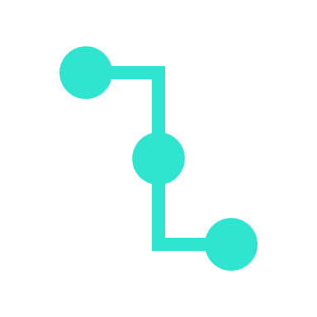
Our vision: Power Virtual Agents
ENGAGE NATURALLY
Engage with your customers and employees conversationally. Resolve routine issues easily, freeing up staff to focus on complex matters
DEMOCRATIZE AI
Empower your subject matter experts to easily create powerful bots using a guided, no-code graphical interface. No need for developers or data scientists.
CONTINOUSLY IMPROVE
Point the AI to your website, and automatically build topics to get started with a few clicks. As the bot gets used, powerful metrics and insights help tell you what topics to build next
Empower every organization to easily provide delightful, natural interactions with their customers and improve engagement and outcomes
TAKE ACTION
Connect to your backend systems with a few clicks using the hundreds of connectors that come with Power Platform – or call APIs and custom workflows using Power Automate. The full power of the Microsoft Bot Framework is only a few clicks away.

Slide 10
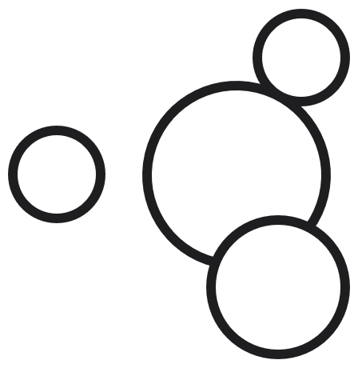

Microsoft Power Platform
The low-code platform that spans Office 365, Azure, Dynamics 365, and standalone applications
Innovation anywhere. Unlocks value everywhere.
Power BI
Business analytics
Power Apps
Application development
Power Automate
Process automation
Power Virtual Agents
Intelligent virtual agents
Data connectors
Portals
AI Builder
Common Data Service

Slide 11
Power Virtual Agents is Designed For Everyone The chatbot service that enhances everyone’s experience
Your Customers
Subject Matter Experts
IT Admin/Dev

Slide 12
A Robust Virtual Agent Platform
Easily build powerful conversations
Create personalized customer experiences
Limitless extensibility with Bot Framework Skills
^{preview}

Slide 13
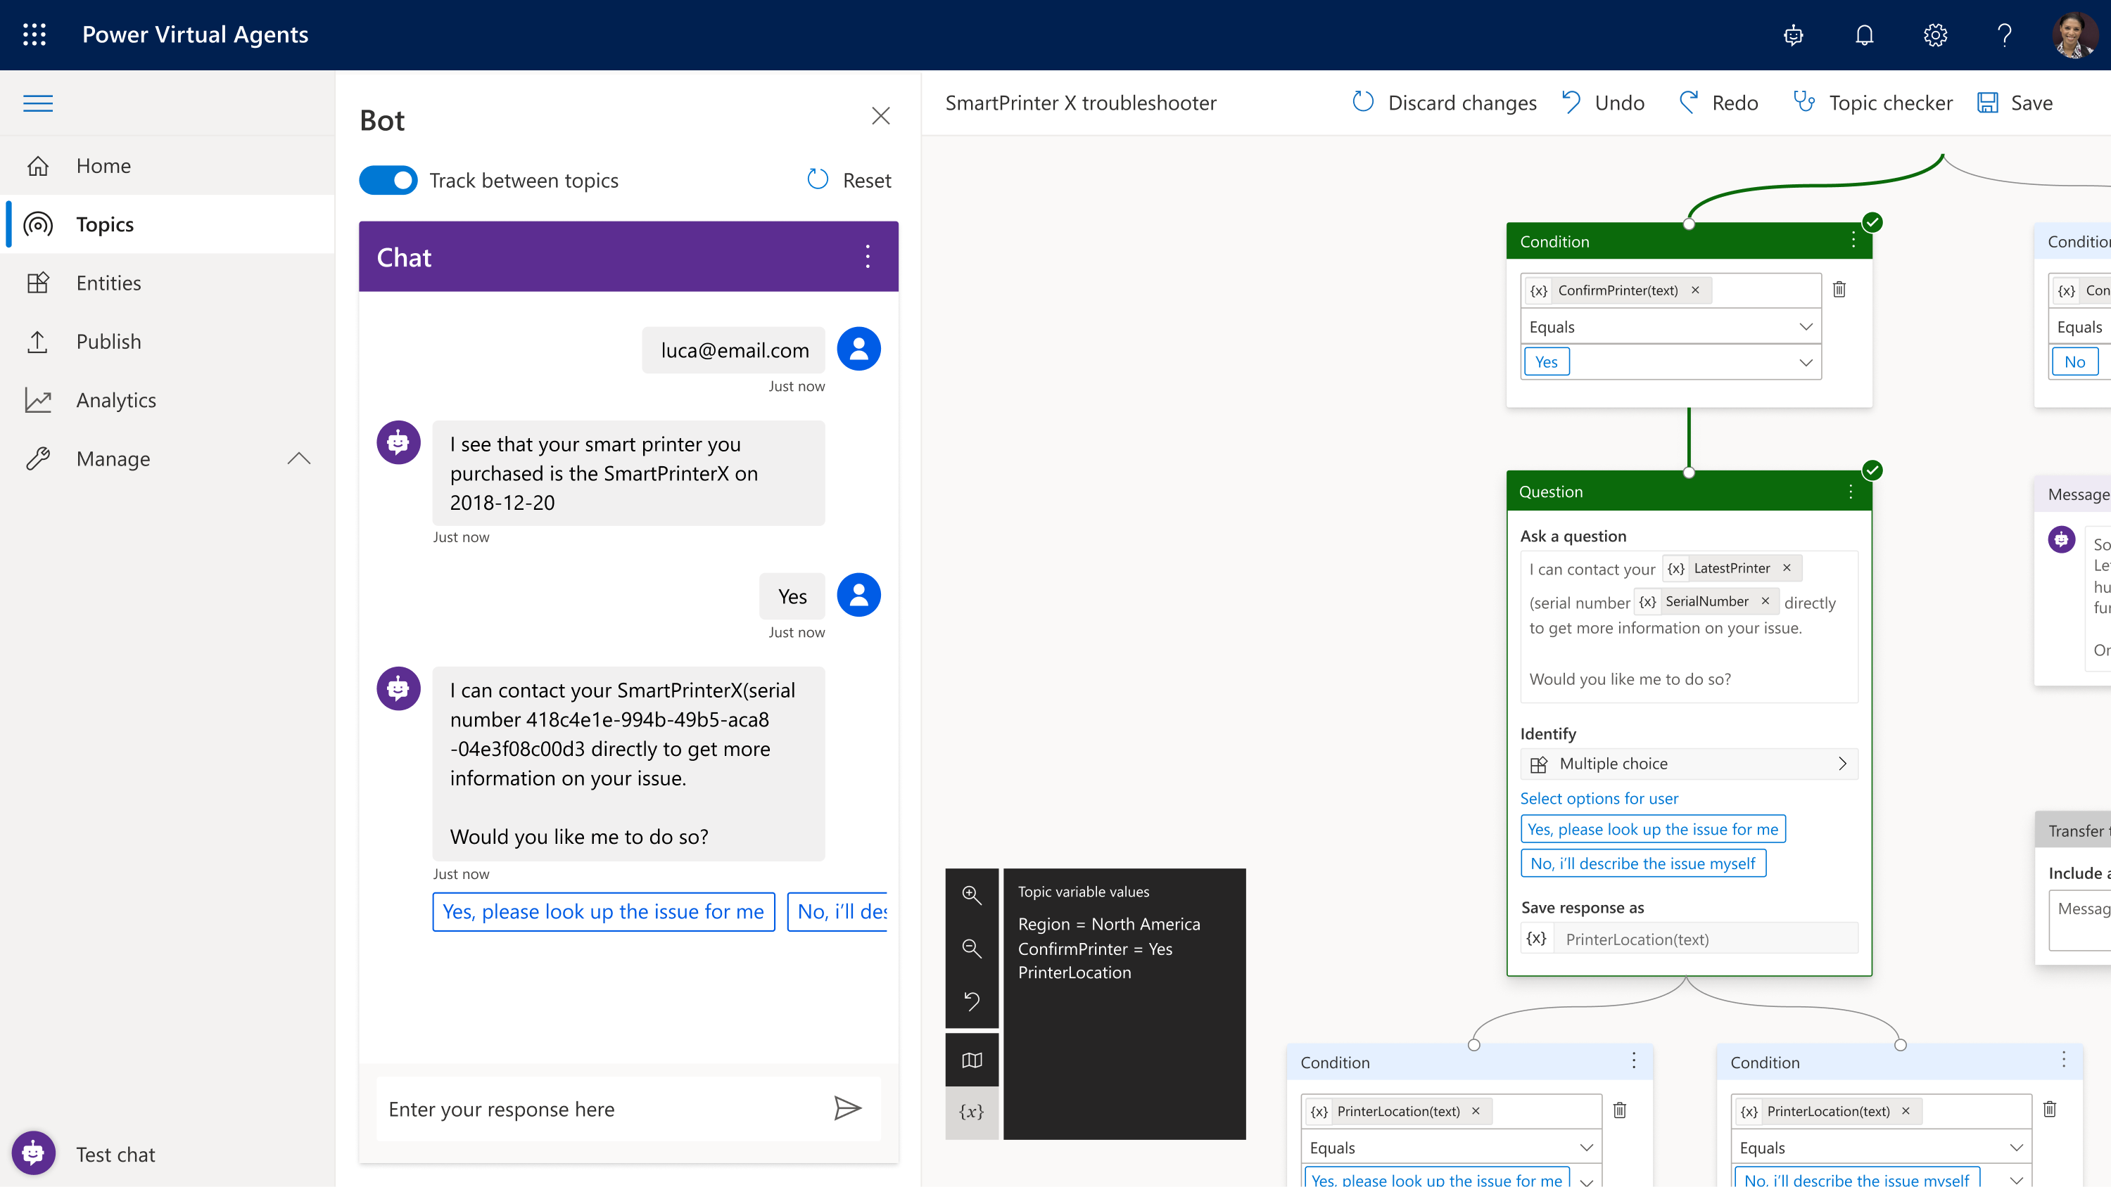
Making Bots Easy
Simple, graphical bot creation
Easily test and maintain bots through a simple, easy to use graphical interface
Extract information from user responses
Recognize, extract, and act on common entities in a user’s responses. For example, colors, currencies, ages, dates and times. Or create your own custom entities, e.g. model numbers
Remember user responses
Store user information for use later in variables and use them to branch or create personalized conversations

Slide 14
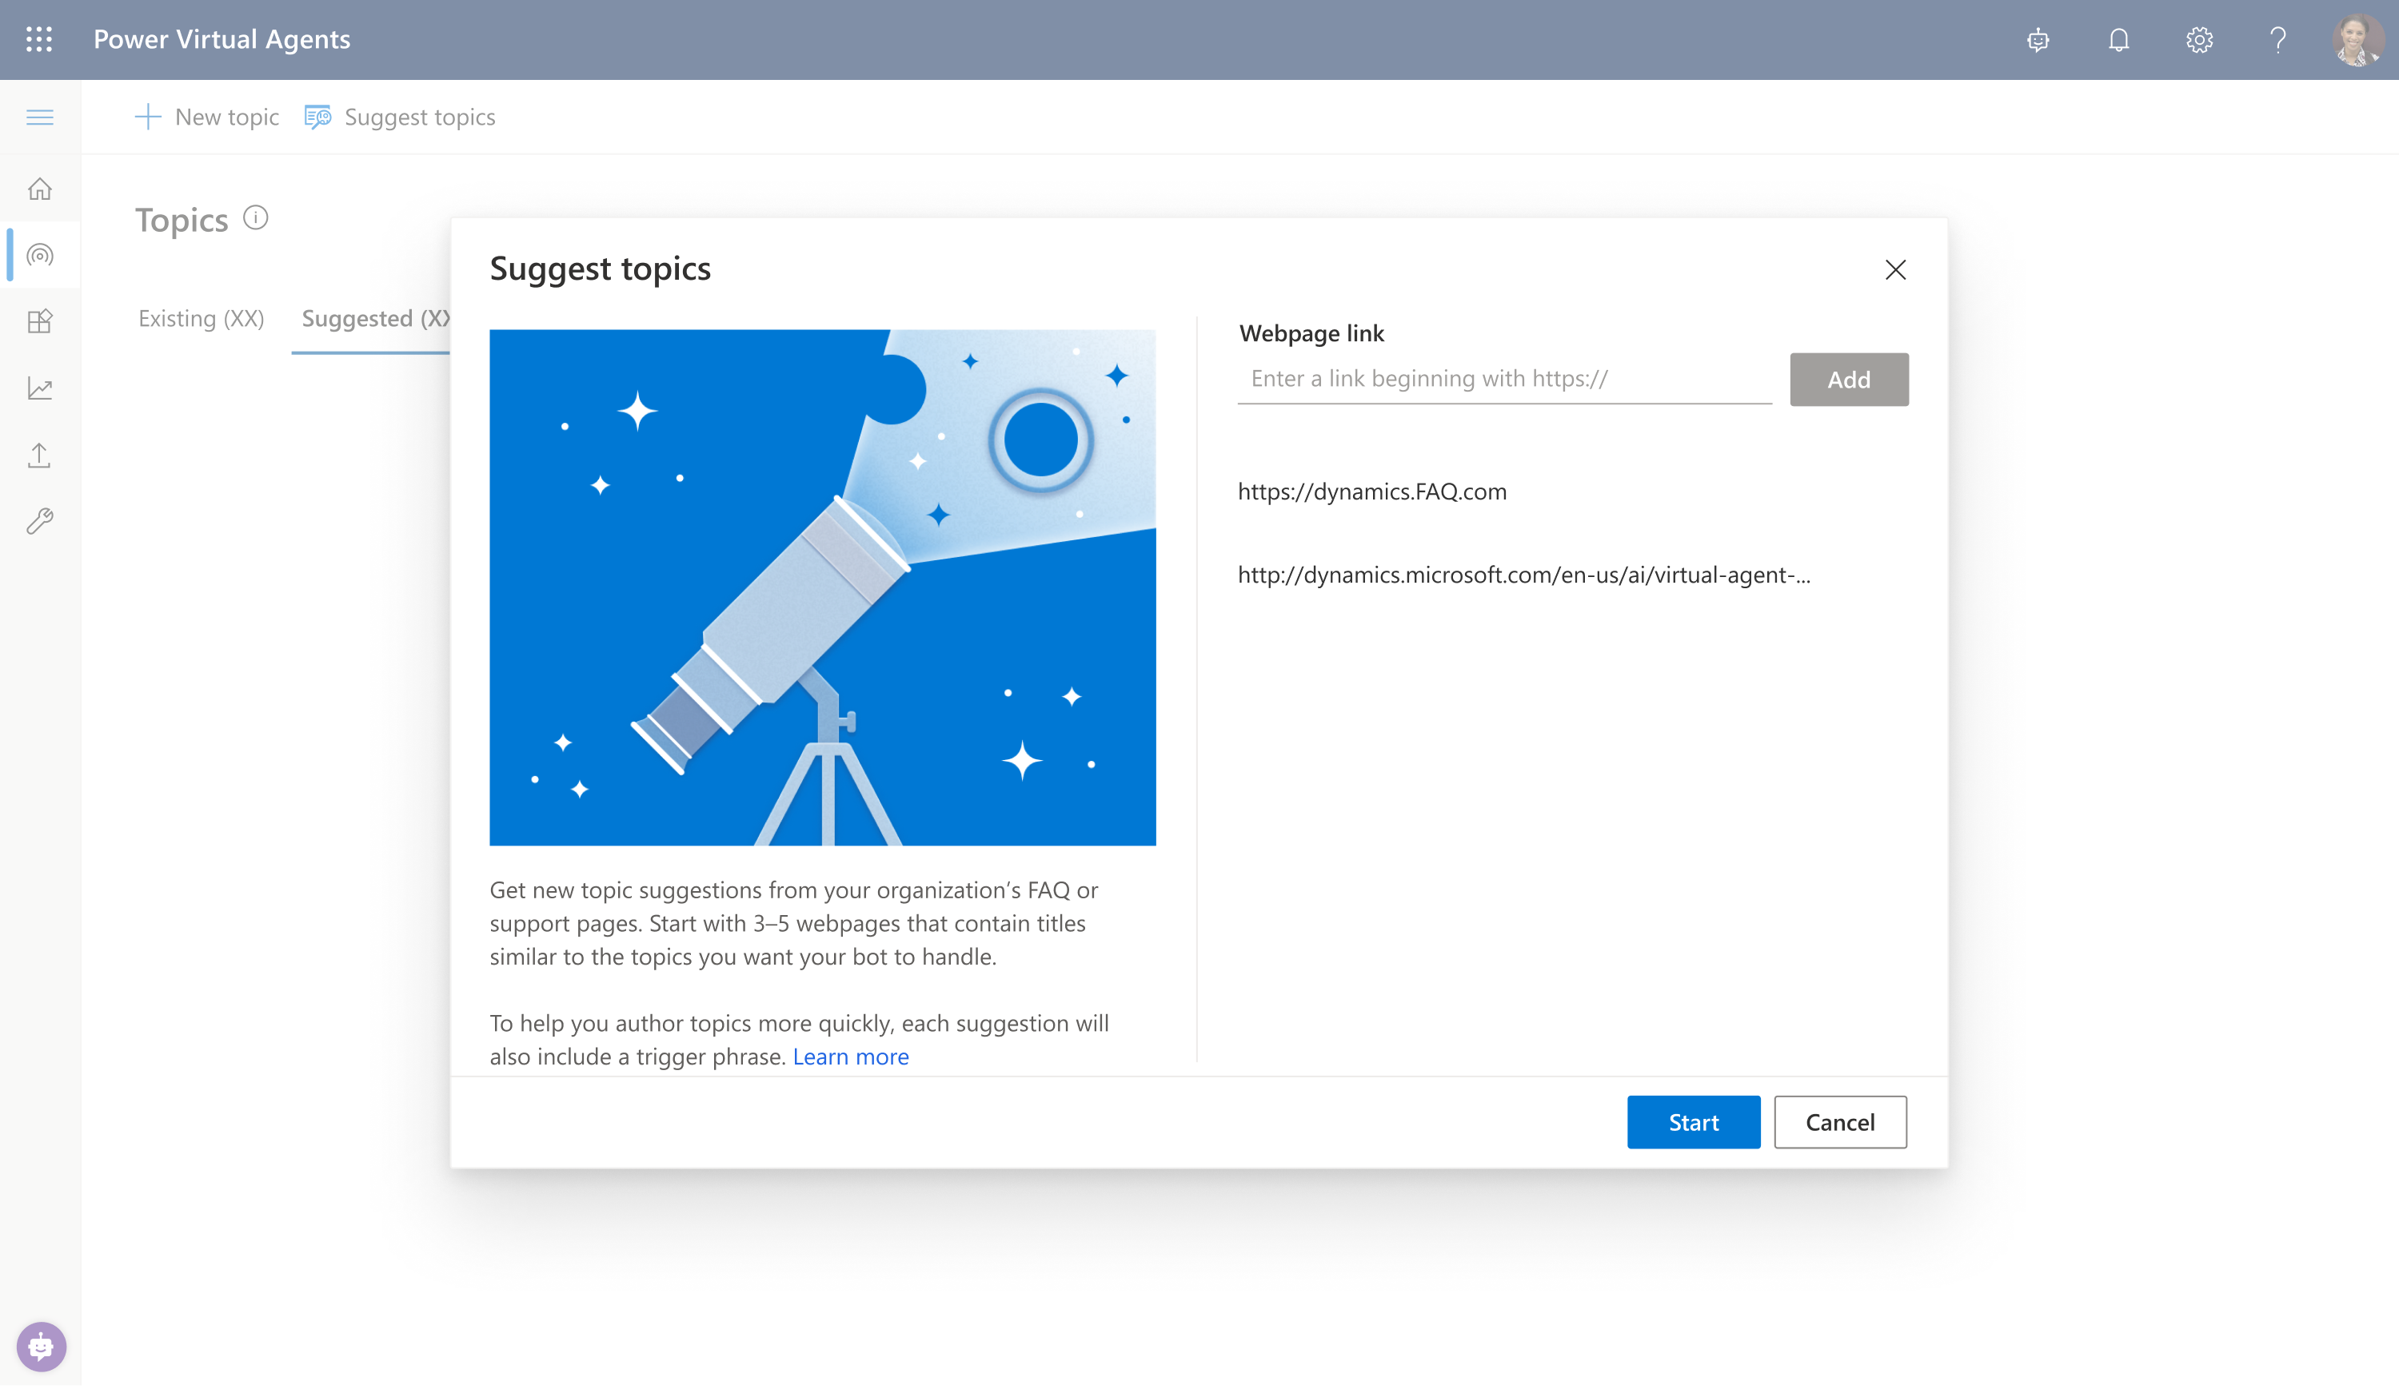
Get Started Quickly
Learn from your website
Just point the bot to your website, and it will extract common questions, FAQs and pre-build topics for you – so you can be up and running in minutes - out of the box.

Slide 15
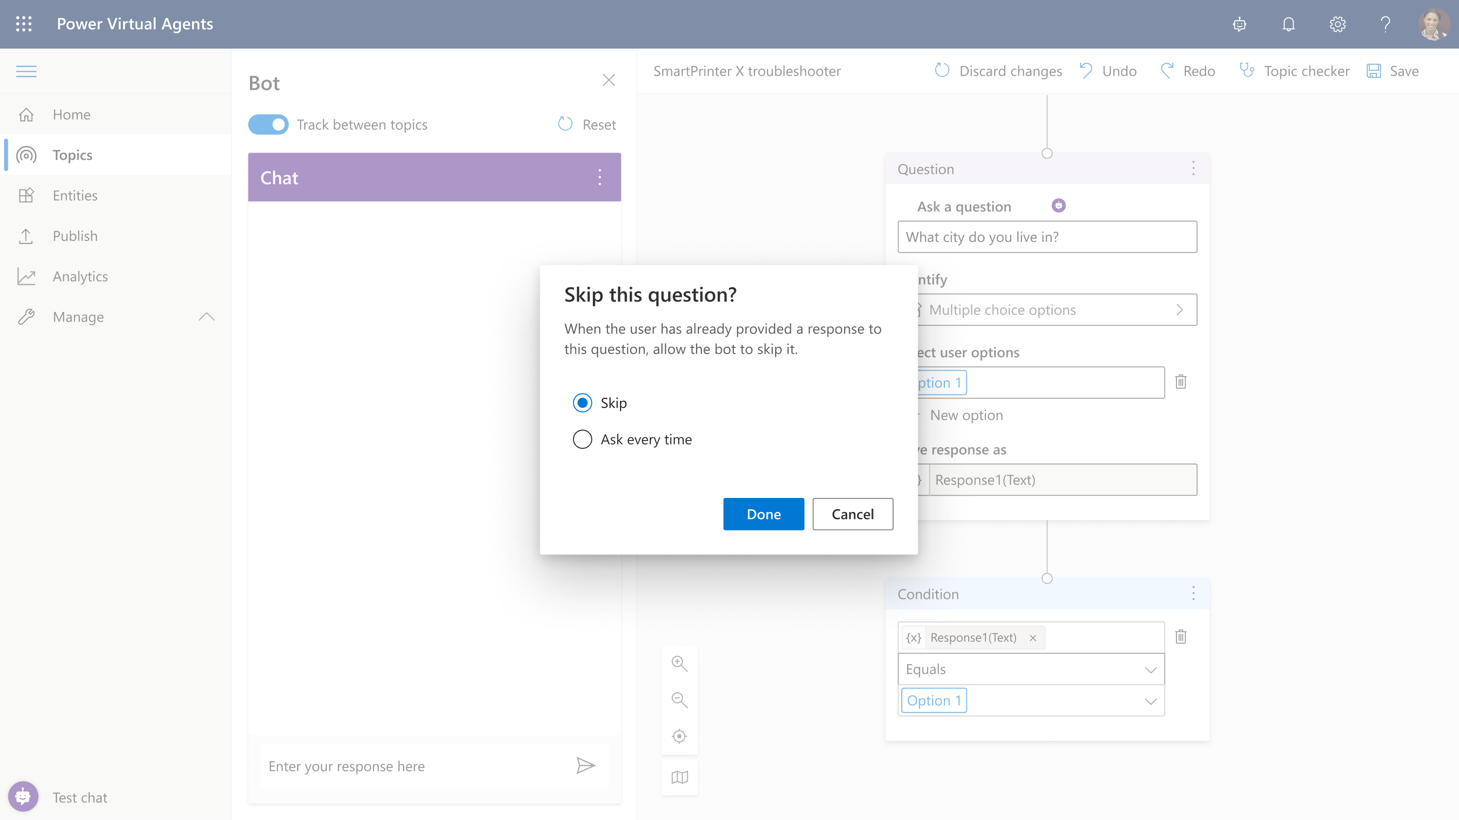
Avoid Repetitive Conversations
Slot-filling capabilities
The bot doesn’t follow the dialog script blindly. It intelligently uses all the information it has to decide when to ask a question and when to skip them.
For example, if the user provided information earlier in the conversation, the bot will remember it and skip asking about it again

Slide 16
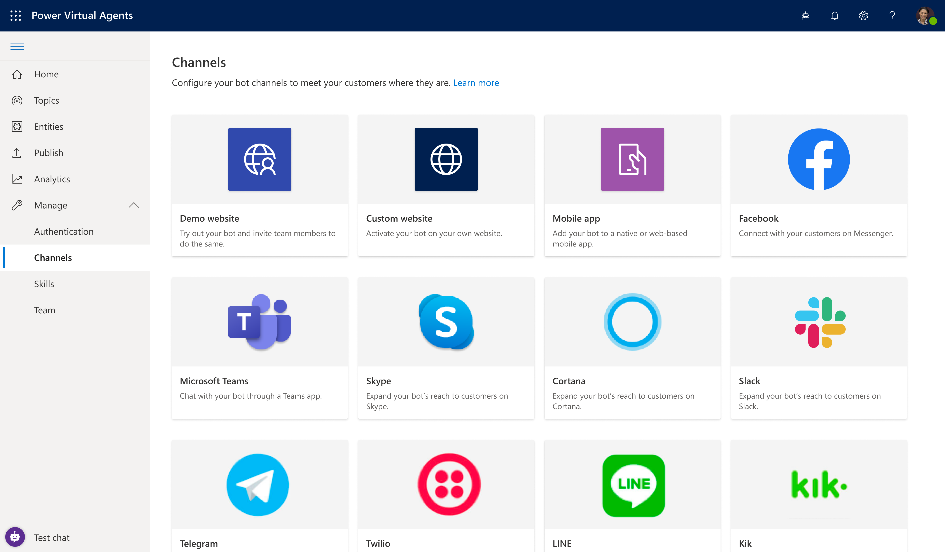
Converse everywhere
Use bots wherever you need them:
Configure and deploy to multiple channels
Easily embed your bot wherever your organization engages with customers: websites, mobile apps, Facebook, Teams or any of the dozens of channels supported by Azure Bot Service
Deploy to demo sites with a single click
Test and gain feedback by deploying your bot to a demo website and sharing it internally with colleagues, before embedding it to your own website when ready

Slide 17
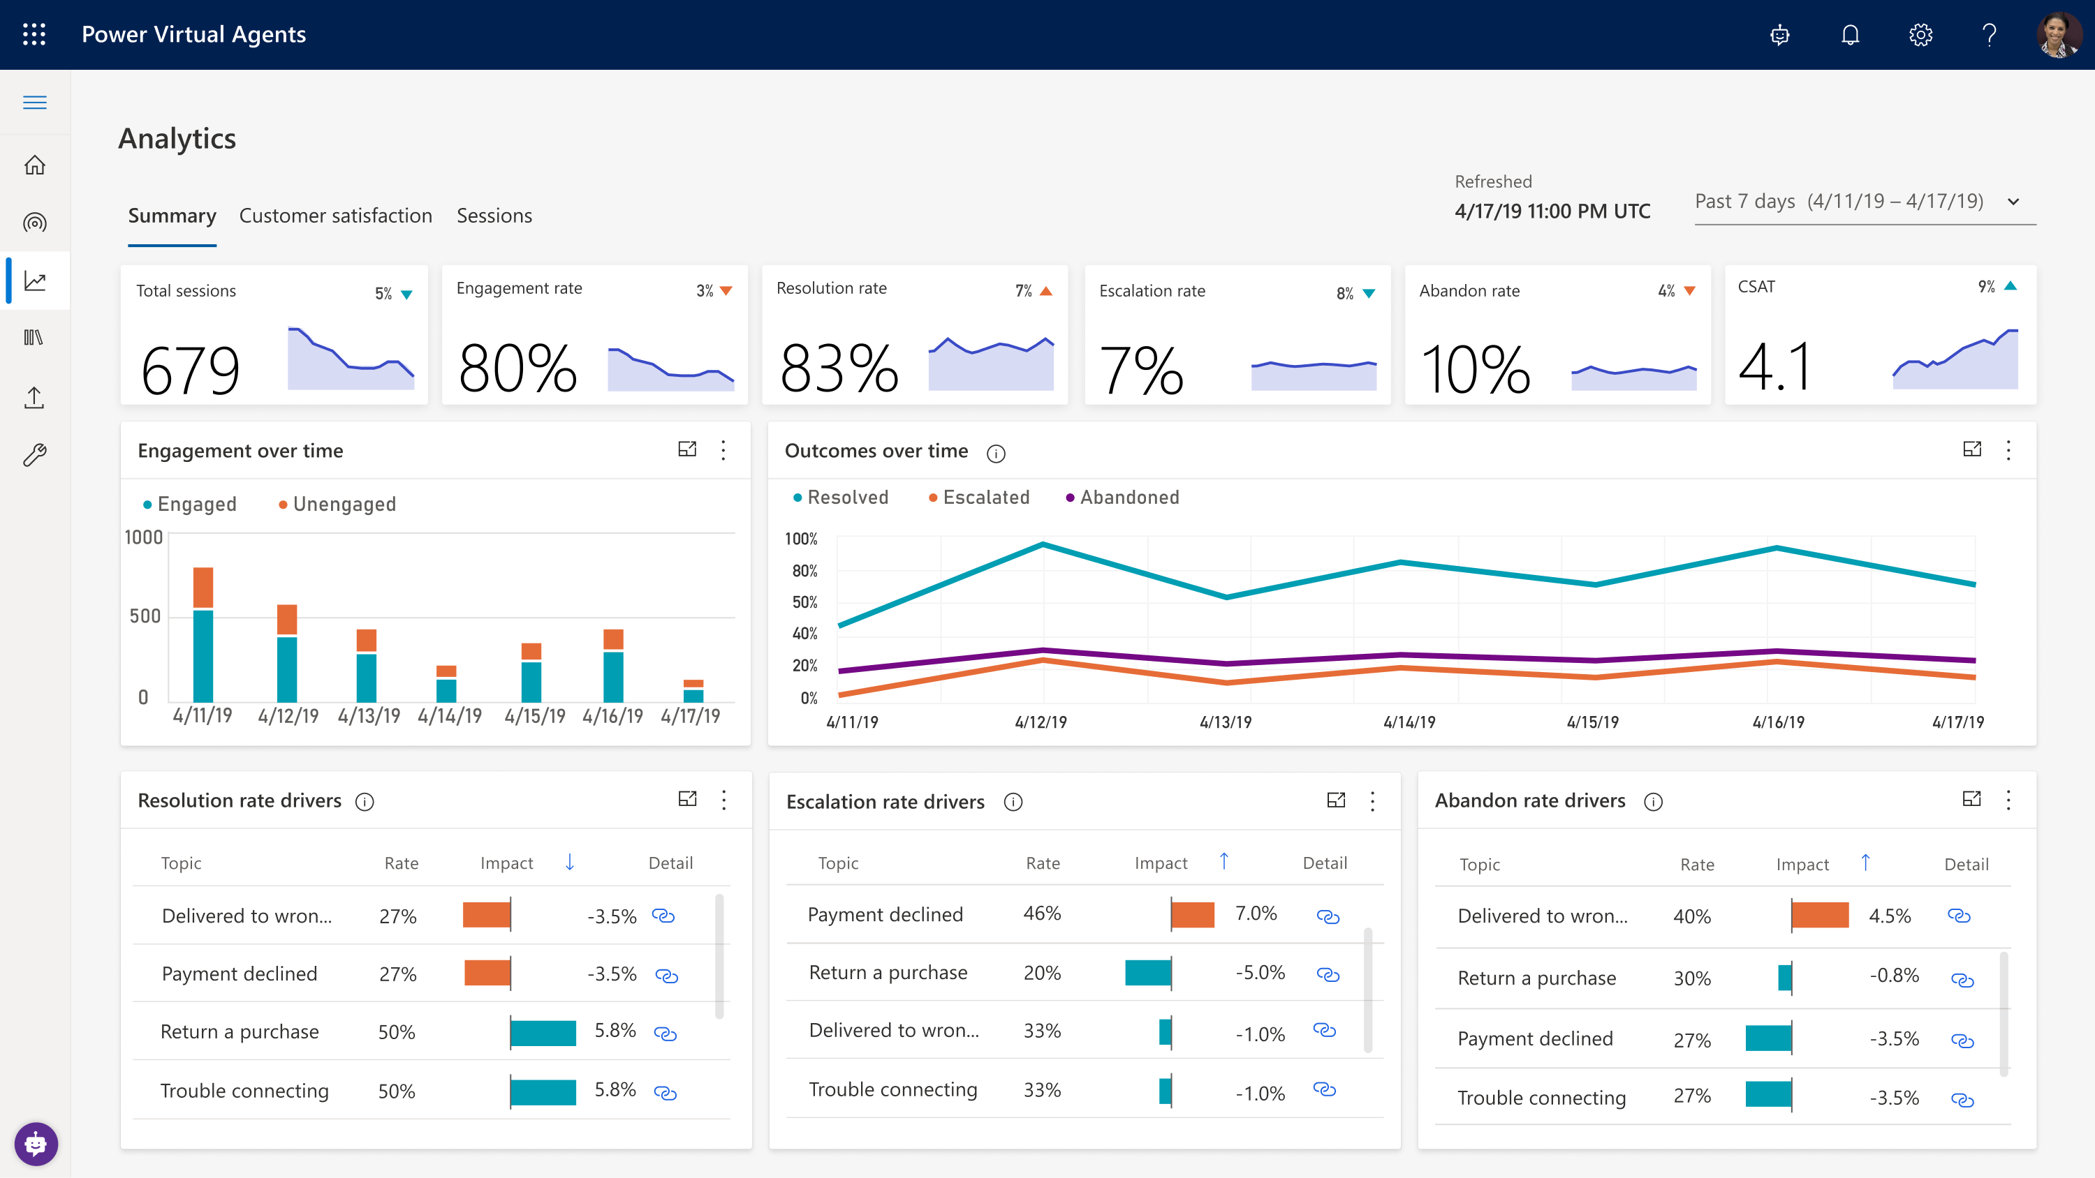
Easily make your bots better
Easily see what’s working – and what to improve
Analyze bot / customer conversations to better understand how specific topics are performing, what’s impacting your CSAT, and identify where there is room for improvement
Quickly figure out what to build next
Easily see which conversations are going to human agents and determine which topics to teach your bot next

Slide 18

Demo
Easily build powerful conversations
Notes:
https://docs.microsoft.com/en-us/powerapps/maker/model-driven-apps/model-driven-app-overview
https://docs.microsoft.com/en-us/powerapps/maker/model-driven-apps/build-first-model-driven-app
https://docs.microsoft.com/en-us/powerapps/maker/model-driven-apps/model-driven-app-components

Slide 19
Demo: Easily build powerful conversations
Learning 1:
Easy to create, build, test and deploy a virtual agent. You can focus on content.
Learning 2
Advanced AI capabilities help the chatbot become smarter and create a great customer experience.
Learning 3:
Extend your chatbot by leveraging Power Automate and 100s of pre-build connectors.

Slide 20
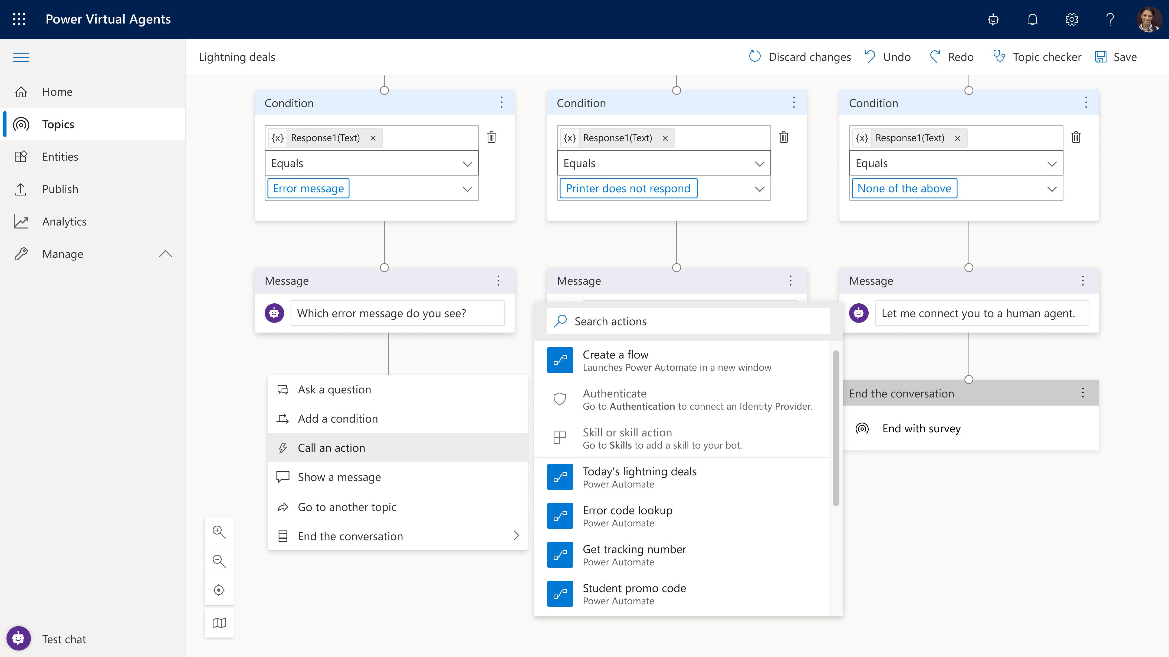
Create personalized customer experiences
Extend bot conversational capabilities with Power Automate.
Enable your bot to act on behalf of your customer
Enable actions/access data from back-end systems
Recognize your customer
Allow the bot to access the user’s information and take action on their behalf

Slide 21
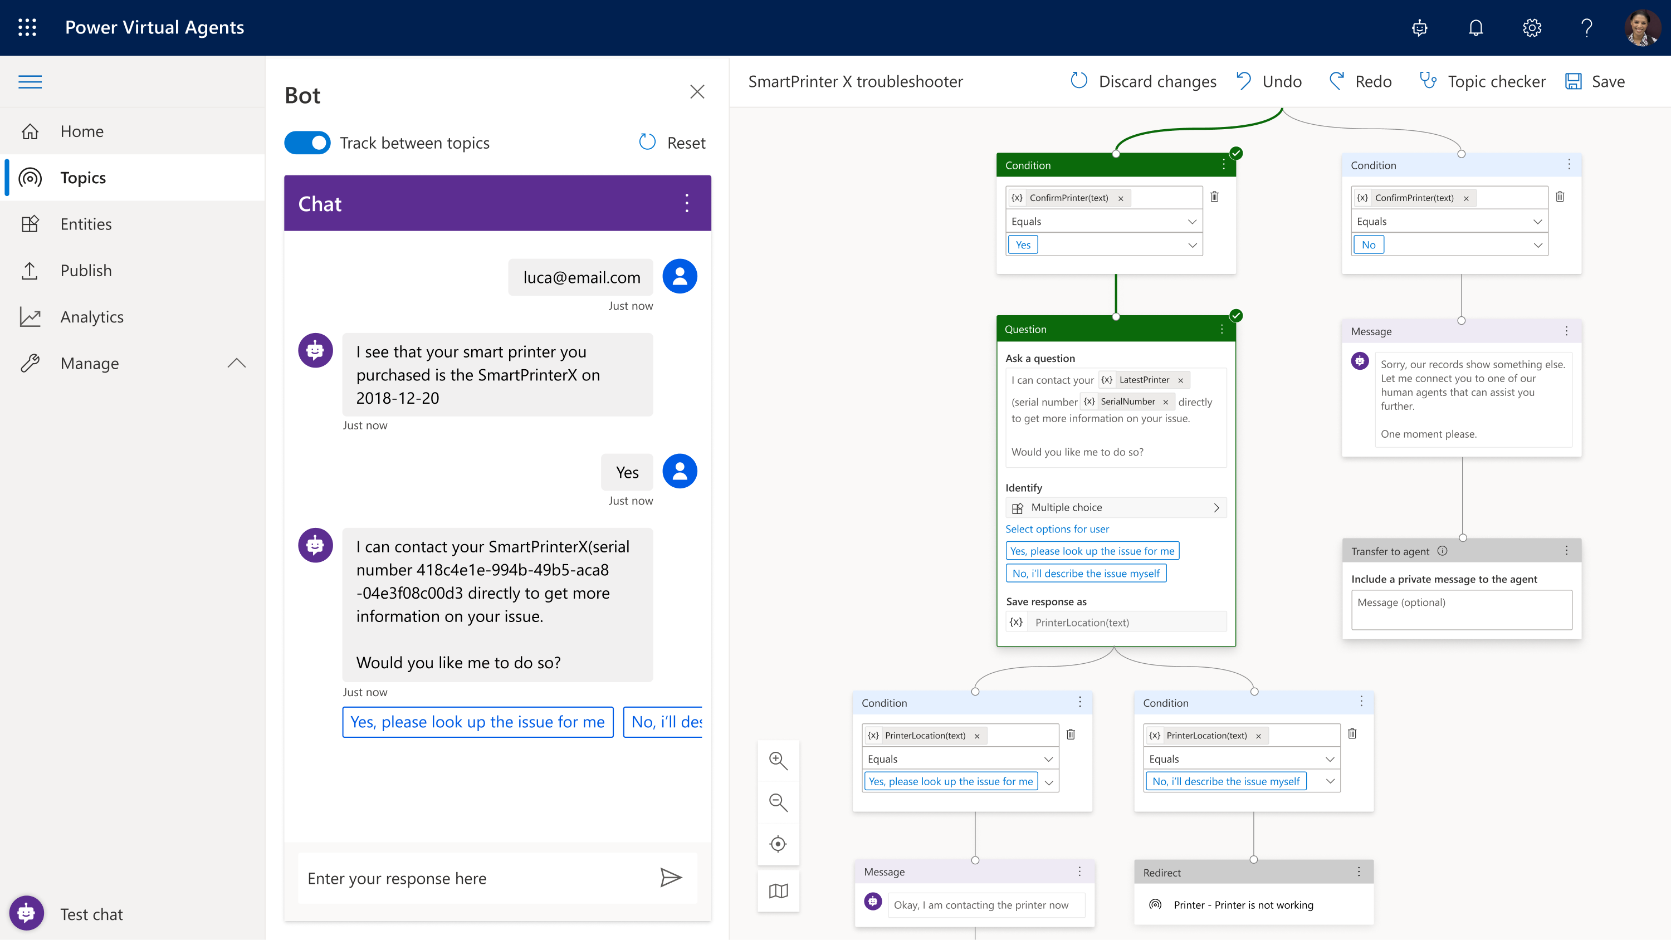
Transfer to a human agent
Configure and connect a bot to a human.
Hand-off to Dynamics 365 Omnichannel for Customer Service
Benefit from native integration to enable a hand-off from bot to live chat
Hand-off to generic live-chat provider
Extend hand-off capability to other providers

Slide 22
Demo
Personalize your customer experience
Notes:
https://docs.microsoft.com/en-us/powerapps/maker/model-driven-apps/model-driven-app-overview
https://docs.microsoft.com/en-us/powerapps/maker/model-driven-apps/build-first-model-driven-app
https://docs.microsoft.com/en-us/powerapps/maker/model-driven-apps/model-driven-app-components

Slide 23
Demo: Personalize your customer experience
Learning 1: Extend your virtual agent with extended Power Automate capabilities
Learning 2: Personalize your customer experience with feature such as customer authentication

Slide 24
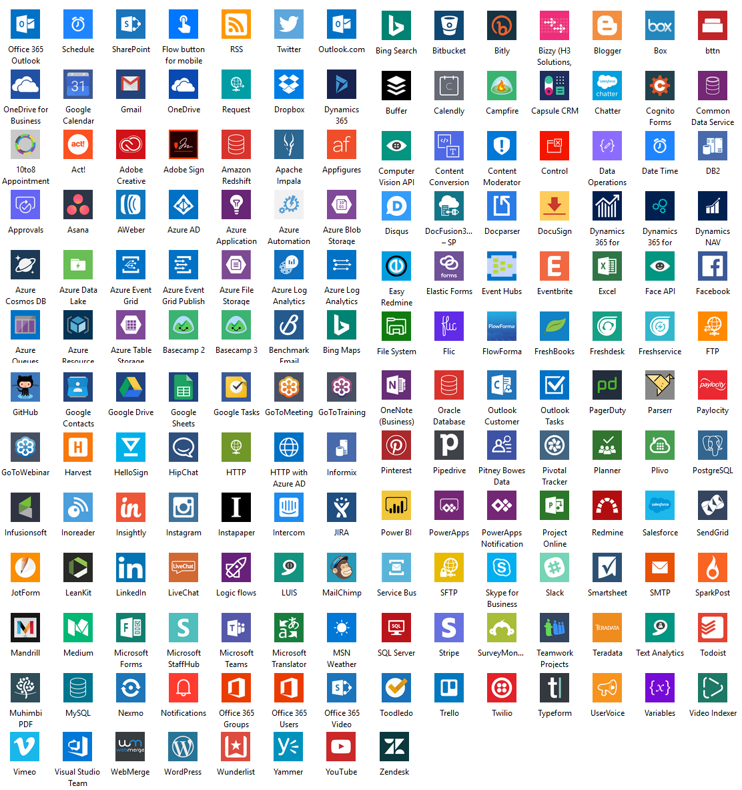
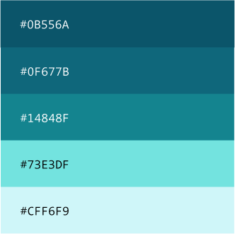
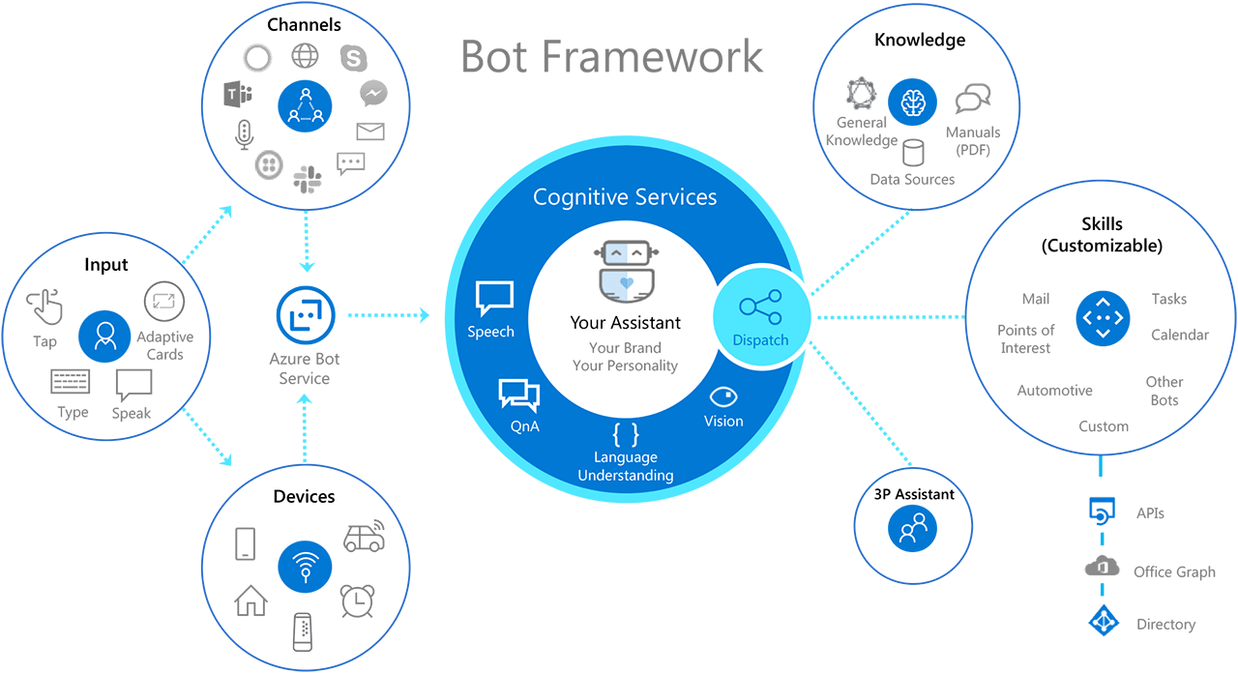
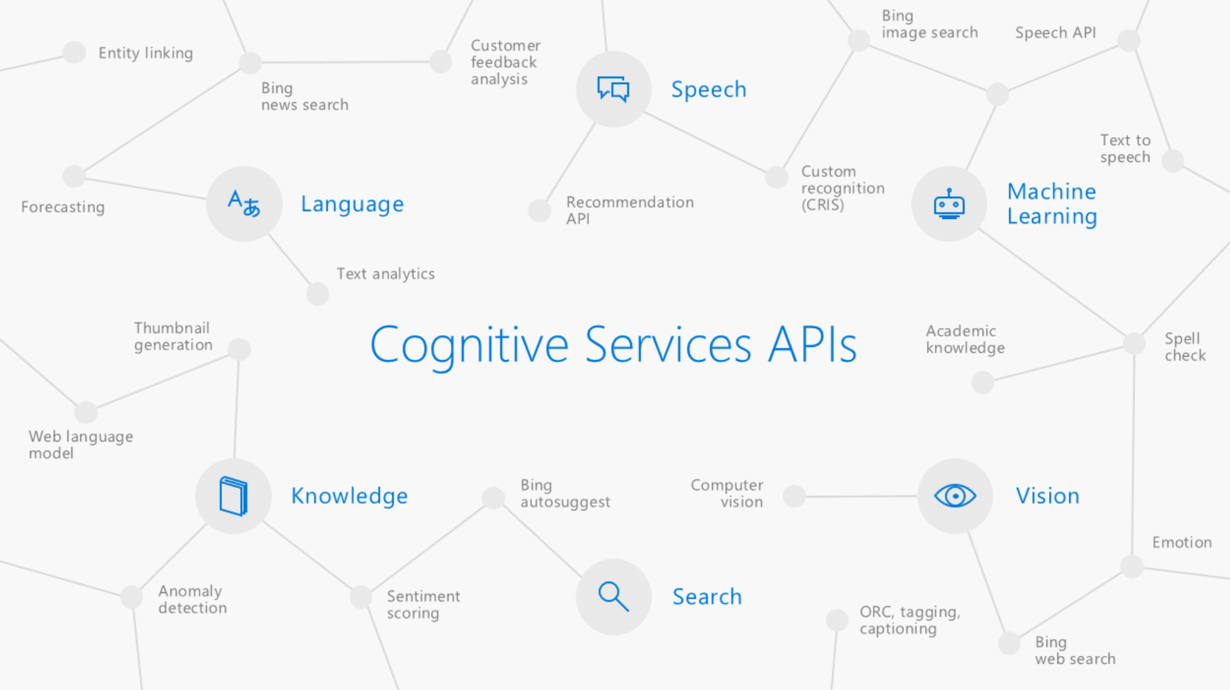
Built on Power Platform & Azure Bot Service
Power Virtual Agents
Power Platform Access to Flow, custom models through AI Builders and 100s of pre-built connectors
Azure Bot Service Easy, no-cliff access to the full power of the Azure Bot Framework
Azure Cognitive Services
Integrated with Azure Cognitive Services
Primary: Header, button links
Secondary: Text hyperlinks
Tertiary: Icon, UI details
Accent: Icon, Sparingly used
Accent: Icon, Sparingly used

Slide 25
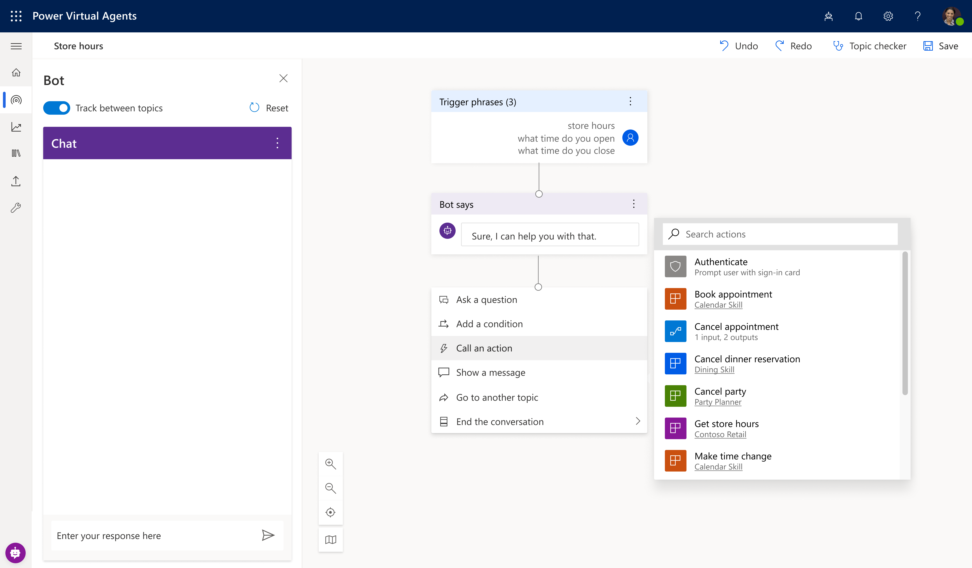
Extend your bot capabilities with Azure Bot Service
^{preview}
Microsoft Bot Framework Skills Support
Skills are reusable conversational dialogs that can be used to author scenarios using complex capabilities. Bot authors can convert any existing bot into a Skill and seamlessly trigger actions embedded in it through our no-code designer.

Slide 26
Demo
Create and deploy a Power Virtual Agents bot
Notes:
https://docs.microsoft.com/en-us/powerapps/maker/model-driven-apps/model-driven-app-overview
https://docs.microsoft.com/en-us/powerapps/maker/model-driven-apps/build-first-model-driven-app
https://docs.microsoft.com/en-us/powerapps/maker/model-driven-apps/model-driven-app-components

